Slide 1

welcome
Jonathan Popham

Slide 2
Thanks
Big thanks to

Slide 3



Who am I?
Organizer
GDG ATL
President
Freeside
User Interface Developer
ADP
Notes:
Hat Dance time! meetup.com/gdg-atlanta
wiki.freesideatlanta.org
adp.com

Slide 4

Why am I doing this?
Linus's Law :
says that all of our motivations fall into three basic categories. More important, progress is about going through these very same things as “phases” in a process of evolution, a matter of passing from one category to the next. The categories, in order, are “survival,” “social life,” and “entertainment”.
I do all of this, just for the fun of it.
Notes:
The Hacker Ethic and the Spirit of the information Age foreword.
Also a book called Just for Fun, by Linus Torvalds.
Linus's Law :
says that all of our motivations fall into three basic categories. More important, progress is about going through these very same things as “phases” in a process of evolution, a matter of passing from one category to the next. The categories, in order, are “survival,” “social life,” and “entertainment”.

Slide 5
Who are you?
Stand up
Right now, I really mean it
Tell your name to the people around you
If it is a fake name it has to be hilarious
Tell at least one person something you like to do, just for the fun of it.

Slide 6
<polymer-project>
// web component library
Notes:
Brace yourself, we are about to reach web design singularity W3C Web Components Specifications
Polymer-Project page
Rob Dodson Polymer install walkthrough
Polymer Core
polymer designer
Component Kitchen
bower
Grunt Task Runner
http://www.html5rocks.com/en/tutorials/webcomponents/yeoman/

Slide 7
What we’re talking about
a large molecule, or macromolecule, composed of many repeated subunits, known as monomers
Polymer is a library
uses the latest web technologies
lets you create custom HTML elements
polyfill of web components
Notes:
It is like a chemical polymer ( like PVC, PEP) in the sense that on a high level have small modular components which can be snapped together.

Slide 8
Web component Libraries
Polymer (via Chrome via Google)
focused on bringing future standards to browsers
X-Tags from Mozilla
similar vision to Polymer, works with key people from Google and webcomponents.org
Bosonic
relative newcomer to the scene
focused on bringing old browsers to the present

Slide 9
What we’re talking about
Polymer
Web Components in general
Materials Design
What the landscape looks like for the future
The Mystical, Magical, Shadow DOM

Slide 10
Status of Polymer
Out of Beta!
Works on latest 2 versions of evergreen browsers
Chrome
Firefox
IE
Safari
Opera
Notes:
In Beta
@@Developing web standards still@@
Works on latest 2 versions of
Chrome
Firefox
IE
Safari 2
Compatibility filled in with something called polyfills

Slide 11
Polymer is a library
“Build anything from a button to a complete application as an encapsulated, reusable element that works across desktop and mobile.”
Polymer is a way of bolting together web components to make robust web applications.
Notes:
Think of web components like lego bricks

Slide 12
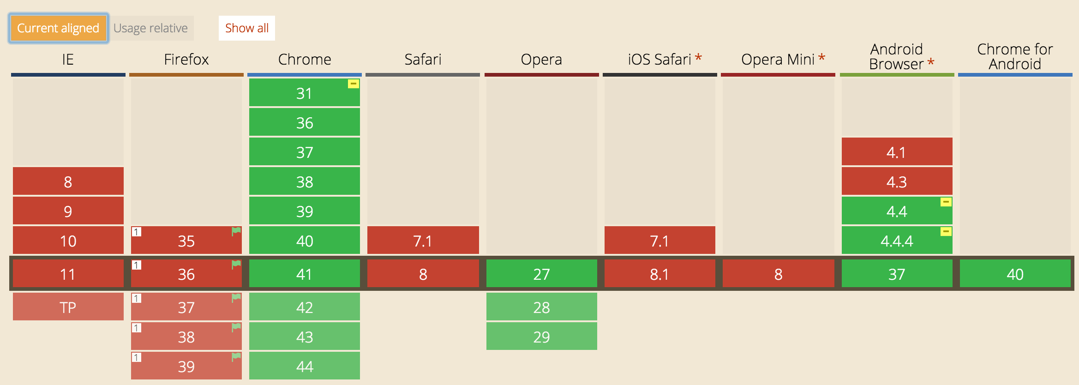
Native (Shadow DOM)
Notes:
Native Browser Support looking pretty gross.

Slide 13

webcomponents.js
Notes:
Was called platform.js, developed by the Polymer Team,
opened up and put on webcomponents.org

Slide 14
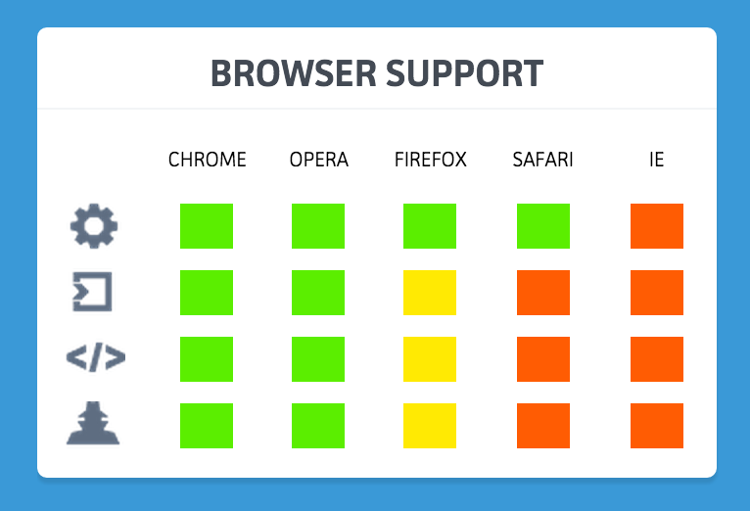
webcomponents.js

Slide 15
Polymer Layout
Applications
Paper Elements
Core Elements
Polymer.js
Polyfills (webcomponents.js)
Native Support
Notes:
Polyfills are for Mutation Observers
Pointer Events
Shadow
Custom Elements
Html Imports
MDV
Web Animations

Slide 16
Web components via W3C
Templates
Custom Elements
Shadow DOM
Imports
Notes:
http://www.w3.org/TR/components-intro/ Templates, which define chunks of markup that are inert but can be activated for use later.
Custom Elements, which let authors define their own elements, with new tag names and new script interfaces. also extend existing elements like button
Shadow DOM, which encapsulates a DOM subtree for more reliable composition of user interface elements.
Imports, which defines how templates, decorators and custom elements are packaged and loaded as a resource. Dead on Arrival/ May not happen Decorators, which apply templates based on CSS selectors to affect rich visual and behavioral changes to documents.

Slide 17
Web components
All can work individually, you don’t need Polymer to use web components.
Polymer is a discussion whose goal is to form an opinion on what the future of the web is going to look like
Notes:
The polymer team is in a feedback loop with W3C, constantly tweaking and updating what the new standards should include

Slide 18
Shadow DOM
File Structure which encapsulates documents, separates event paths
Effectively a tree of DOM nodes
Definitely mystical, magical
Possibly Yggdrasil (non-normative)
Notes:
http://www.html5rocks.com/en/tutorials/webcomponents/shadowdom-201/ https://w3c.github.io/webcomponents/spec/shadow/ API Shadow DOM can be applied to an element by calling the createShadowRoot method Yggdrasil immense tree that is central in Norse cosmology, in connection to which the nine worlds exist from Dmitry’s blog http://glazkov.com/2011/01/14/what-the-heck-is-shadow-dom/ Shadow DOM refers to the ability of the browser to include a subtree of DOM elements into the rendering of a document, but not into the main document DOM tree. Consider a simple slider:
<input id="foo" type="range">
Pop this code into any WebKit-powered browser, and it’ll appear like so:
Simple enough. There’s a slider track and there’s a thumb, which you can slide along the track.
Wait, what? There’s a separate movable element inside of the input element? How come I can’t see it from Javascript?
var slider = document.getElementsById("foo"); console.log(slider.firstChild); // returns null
Is this some sort of magic?
No magic, my fair person of the Web. Just shadow DOM in action. You see, browser developers realized that coding the appearance and behavior of HTML elements completely by hand is a) hard and b) silly. So they sort of cheated.

Slide 19
Structure of Shadow DOM
Document
Shadow Host (inert)
Shadow Root
encapsulated content
Notes:
Shadow dom keeps styles from “bleeding”, in case something has the same class name or id name. the encapsulated content is separate from anything else in the rest of the document

Slide 20
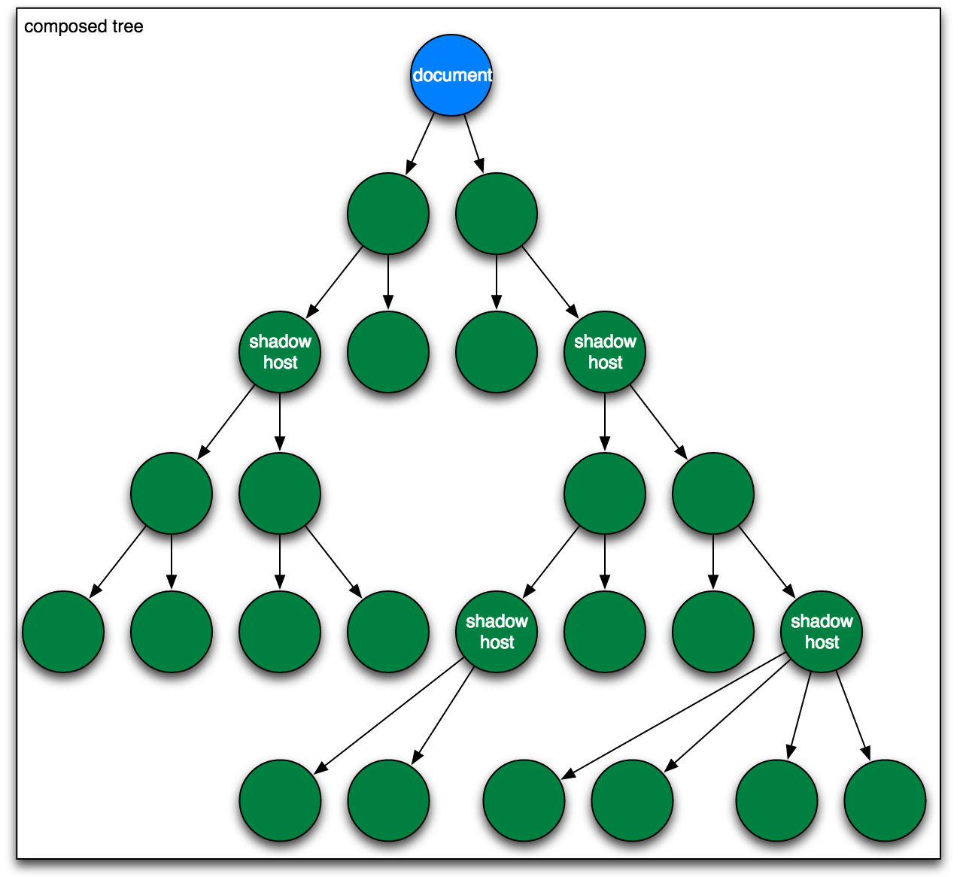

Slide 21
Create Shadow Host (js)
var host = document.querySelector(‘#host’);
var root = host.createShadowRoot();
var content = document.createElement(‘content’);
content.setAttribute(‘select’,’h1’);
root.appendChild(content);

Slide 22
Create Shadow Host (html)
<div id=”host”>
<h1>Mystical Magical Shadow Dom</h1> </div>

Slide 23
That’s cool but...
What can you really do with this?

Slide 24
Declarative Event Mapping
<polymer-element name="tag-name" constructor="TagName"> <template> <!-- shadow DOM here --> </template> <script> Polymer({ // properties and methods here }); </script> </polymer-element>
Notes:
Preferred Method for Event mapping
At the heart of Polymer are Custom Elements. Thus, it should be no surprise that defining a Polymer element is similar to the way you define a standard Custom Element. The major difference is that Polymer elements are created declaratively using <polymer-element>
Declarative event mapping happens in your markup (HTML5)
Useful for when you are dealing with legacy code that you can touch and you need to do work on a website anyway.

Slide 25
Custom Elements
which let authors define their own elements, with new tag names and new script interfaces. also extend existing elements like button
encapsulates state <element extends="button" name="fancy-button"> </element>
Notes:
https://w3c.github.io/webcomponents/spec/custom/ 5.1 definitng a custom element http://www.w3.org/TR/components-intro/ “The extends attribute specifies the tag name of the kind of element this element is an extension of. Instances of the custom element will have the tag name specified here.
The name attribute specifies the name of the custom element, by which it will be referred to in markup. These names must include a hyphen.”

Slide 26
HTML Templates
<template id="commentTemplate"> <div> <img src=""> <div class="comment-text"></div> </div> </template>
Notes:
code from http://www.w3.org/TR/components-intro/#template-section “Contains markup intended to be used later” “The content of the <template> element is parsed by the parser, but is inert: scripts aren’t processed, images aren’t downloaded, and so on”. the <template element> is not rendered. “The <template> element has property called content which holds the content of the template in a document fragment.” The code inside the template is inert until it is needed

Slide 27
HTML Imports
<link rel="import" href="bower_components/polymer/polymer.html">
Notes:
like <link rel=”style” type =”text/css” href=”theme.css”> import is a link type sneak peak at bower which is used to install dependencies (and dependencies of dependencies

Slide 28
Data binding
Polymer supports two-way data binding
extends HTML and DOM APIs which
separates the UI and the model. Updates to the model are reflected in the DOM and user input to the DOM is immediately assigned to the model.
Notes:
not exactly a web component but important to functionality http://www.polymer-project.org/docs/polymer/databinding.html “For Polymer elements, the model is always the element itself.

Slide 29
Data binding
<polymer-element name="name-tag"> <template> This is <b>{{owner}}</b>'s name-tag element. </template> <script> Polymer('name-tag', { // initialize the element's model ready: function() { this.owner = 'Rafael'; } }); </script> </polymer-element>
document.querySelector('name-tag').owner = 'June';
Notes:
MODEL DRIVEN VIEWS
For Polymer elements, the model is always the element itself. For example, consider a simple element:
Polymer supports two-way data binding. Data binding extends HTML and the DOM APIs to support a sensible separation between the UI (DOM) of an application and its underlying data (model). Updates to the model are reflected in the DOM and user input into the DOM is immediately assigned to the model.
The example on the right is how you can update the owner of the ‘name-tag’ object. This will be reflected in view.

Slide 30
So what does polymer do?
The team defines the core api like this: The polymer core API is like Polymer’s opinion, it’s the extra bit that provides the extra sugaring that all Polymer elements use, and is meant to make developing web components much easier.
Notes:
https://github.com/PolymerLabs http://www.polymer-project.org/docs/polymer/polymer.html In this way Polymer is like an exploration. The Polymer team is actively defining the W3C standards for web components and is continuously engaged in discussions with developers and the standards bodies to figure out what makes sense for web components.

Slide 31
Sugaring Layer
Polymer connects all of the ingredients of web components
Web components currently use polyfills (webcomponents.js) to extend functionality of current browsers.
Polymer is working to discover what future best practices will be

Slide 32
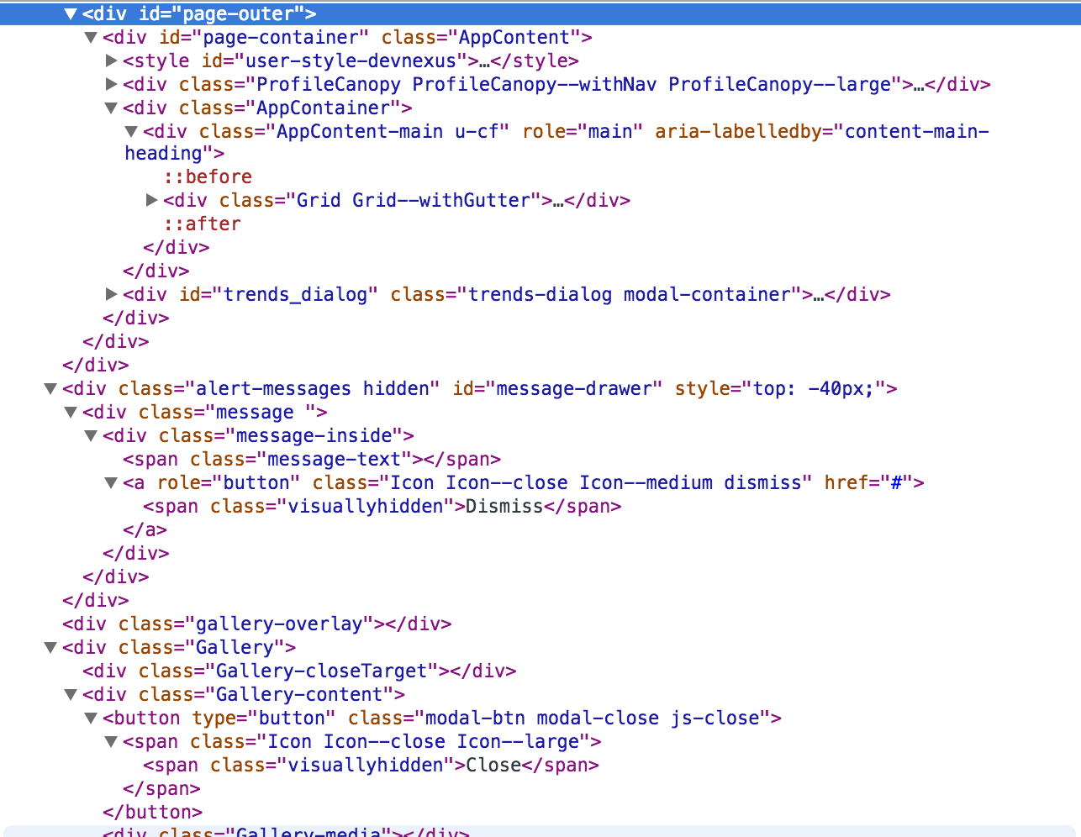
What’s a sugaring layer?
<google-maps>
</google-maps>
Notes:
On the left is the body of a production app without sugaring syntax (div Soup)
On the right is the sugared syntax that you use to declare a google maps element
Sugaring Syntax means it is intended to make code more “palatable” for human users

Slide 33
What polymer looks like
<head> <script src=
”bower_components/webcomponentsjs/webcomponents.js”>
</script> <link rel=”import”
href=”bower_components/polymer/polymer.html”> </head>
Notes:
Imports below metatags <meta charset= “utf-8”> <meta http-equiv=”X-UA-Compatible” content=”IE-edge, chrome=1”>
notice the import link tag?

Slide 34
What polymer looks like
<polymer-element name=”x-foo” noscript> <template> <h1>Hello from x-foo!</h1> </template> </polymer-element>
<x-foo></x-foo> // This is your custom element!
Notes:
Goes inside the <body></body> This is the basic file structure for polymer custom elements, the script would go outside of the template

Slide 35
Stand Up!
75 Minutes is a long time
This is a break I put in so I could keep your attention
Sitting still for this long really sucks
This is an opportunity to receive a Jonathan Point, which are redeemable for fantastic prizes (stickers)
Notes:
Quiz Questions!
First one to answer wins
1. What are the three stages in Linus’s Law?
Survival
Social Order
Entertainment
2. What do you do for fun? (Matter of Opinion)
Program
3. What alternative is there to Declarative Event Mapping?
Imperative Event Mapping
4. Who are the five best rappers in the World? (Not a matter of opinion)
Dylan, Dylan, Dylan, Dylan, Dylan

Slide 36
Quiz Questions! (+1J Point)
1. What are the three stages in Linus’s Law?
Notes:
Survival
Social Order
Entertainment

Slide 37

Notes:
Survival
Social Order
Entertainment

Slide 38
Quiz Questions! (+1J Point)
2. What do you like to do for fun? (Matter of Opinion)

Slide 39
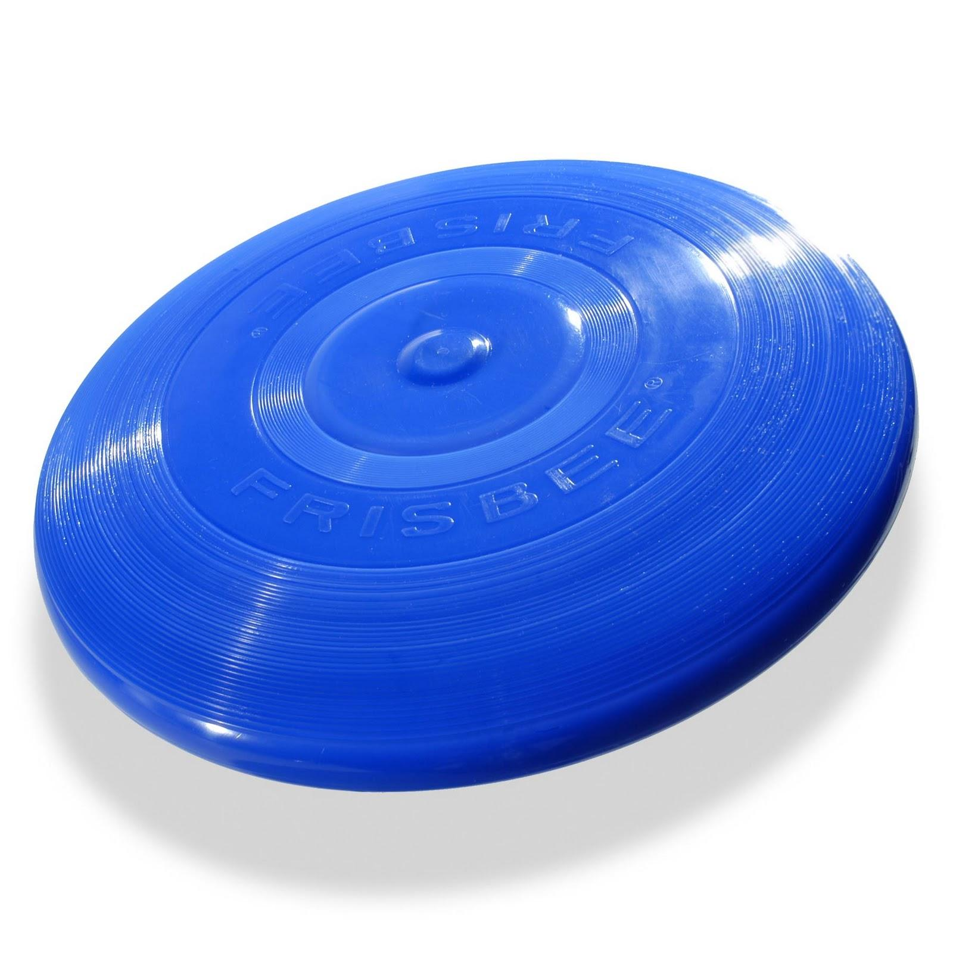
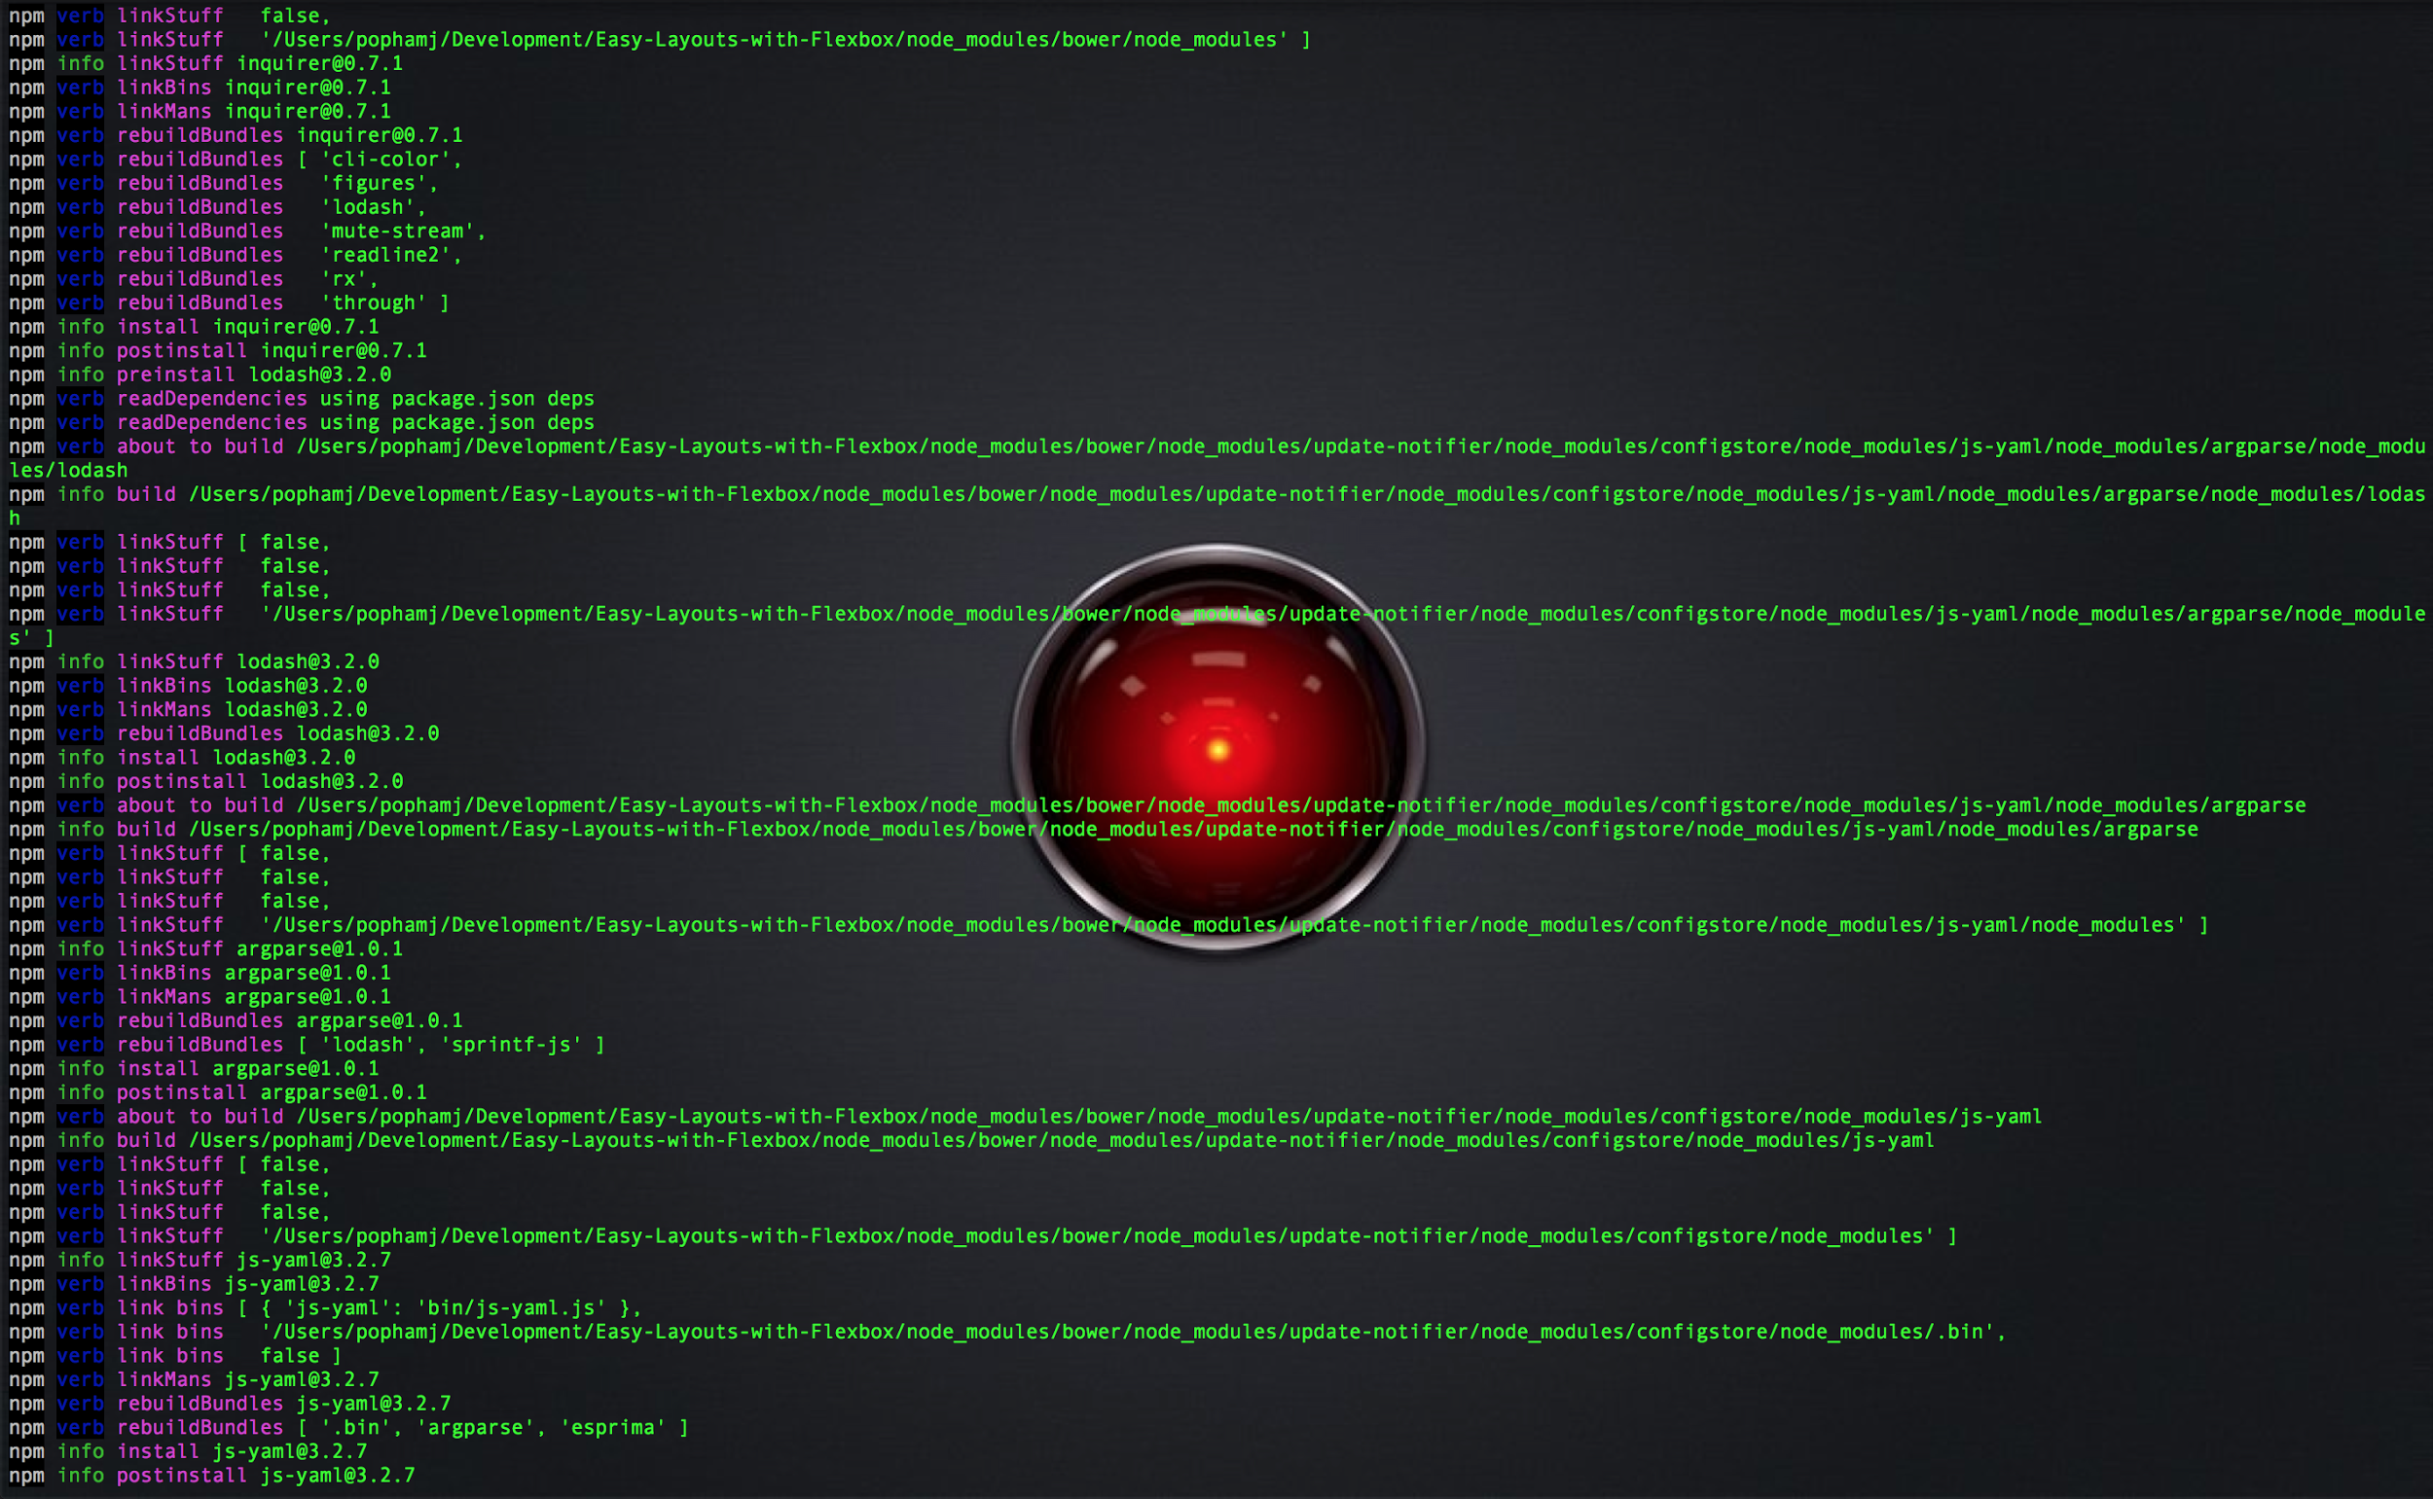
Notes:
I like to play frisbee
I also like to install things in terminal with the --verbose tag
It makes me feel like a hacker

Slide 40
Quiz Questions! (+1J Point)
3. What is the main alternative to declarative event mapping?

Slide 41
Imperative Event Mapping
<script> Polymer('name-tag', {nameColor: 'red'}); var el = document.createElement('div'); el.innerHTML = '\ <polymer-element name="name-tag" attributes="name">\ <template>\ Hello <span style="color:{{nameColor}}">{{name}}</span>\ </template>\ </polymer-element>'; // The custom elements polyfill can't see the <polymer-element> // unless you put it in the DOM. document.body.appendChild(el); </script> <name-tag name="John"></name-tag>
Notes:
You can do it in the javascript too, if you are into this.
Declarative is preferred
you can easily see all of the exposed properties at the top of the element if you use Declarative

Slide 42
Quiz Questions! (+1J Point
4. Who Are the five best rappers in the world?
Notes:
Dylan
Dylan
Dylan
Dylan
Dylan

Slide 43

Notes:
Dylan
Dylan
Dylan
Dylan
Dylan

Slide 44

Install polymer
bower install --save Polymer/polymer
(bower is installed with NPM) bower also makes a bower.json file which contains version info, and dependencies
Notes:
https://github.com/polymer/polymer bower is a package dependency manager, it might seem weird to install a package manager with another package manager, but the purpose of bower is to install your package plus all of the package’s dependencies plus all of those packages dependencies, which is super useful for polymer. it will install platform (so all the plugins that make this work and polymer so you get to have the extra bits the polymer team is experimenting with) bower.json is used to keep track of dependencies, version info,
Recommend using chrome canary

Slide 45
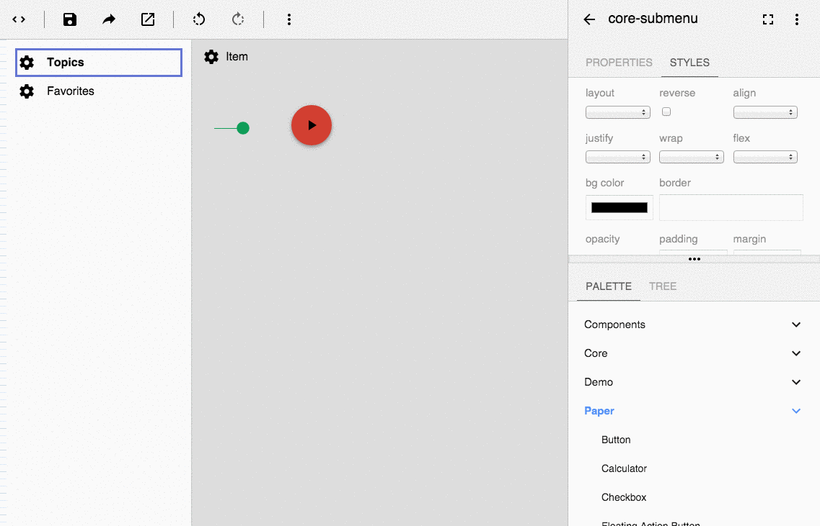
Notes:
Go play with the designer http://www.polymer-project.org/tools/designer/
# slides away

Slide 46
Install designer (lab)
$ git clone https://github.com/PolymerLabs/designer.git
in the root of the project run $ bower install
and load it up in a local server
Notes:
Easy mode 2 slides
https://github.com/PolymerLabs/designer or if you feel hacky….

Slide 47
Fire it up
$ npm install -g serve $ serve //localhost:3000
$ python -m SimpleHTTPServer
//localhost:8000
Notes:
Easy mode next slide
One of the main complaints on the github is that no one understands the step “start local server”, it’s not crazy. Mac and Linux should have Python installed, but if somehow you can’t use that you can also install a node server on your shell and then use serve to serve a local node server in your browser. People also use Grunt and Grunt-cli to run tasks, but I personally don’t know alot about it http://gruntjs.com/installing-grunt

Slide 48
Alternatively (easy mode)
http://www.polymer-project.org/tools/designer/
Notes:
Already open in other tab

Slide 49
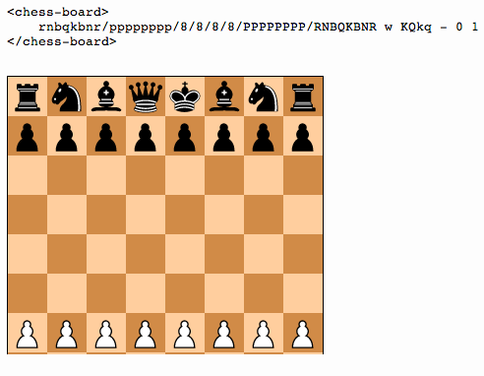
Component.Kitchen
Notes:
Chess Board by Sigurd Fosseng (username:laat)
component.kitchen is an open source custom element library, and in my opinion the kind of thing that will make polymer so super powerful. Once you make a custom element, you can upload your element to bower and then make it available for anyone, who can then add to it and use your element inside of other elements. Polymer is laying down the rootwork for the future where I hope people will make a custom element once, and then never have to write new code for that again. Don’t Repeat Yourself much?
Other people have made libraries that use polymer and platform, and more are being written every day.

Slide 50

customelements.io
Notes:
Big Ol’ Open Source Repository

Slide 51
Notable Polymer stuff
Core-AJAX
Capable of performing XHR requests based on changes in url parameters.
Params are double quoted JSON
Core-XHR
Web browser scripting language API
Receives JSON, HTML, etc.

Slide 52
Notable Polymer stuff
Flexbox!
<div horizontal center-justified layout> <div>center-justified</div> </div>
Notes:
This is all you have to do to center something in a page!
That’s it!
I’m serious!

Slide 53

Other stuff to check out
Notes:
https://github.com/yeoman/generator-polymer

Slide 54

Other Stuff to check out
Notes:
swagger.io
it’s a way to make restful api’s with Polymer
I’m still learning about it personally

Slide 55
Materials Design
Create a visual language that synthesizes classic principles of good design with the innovation and possibility of technology and science.
Everything is a physical object
Everything is in rendered in 3D
It’s awesome
Notes:
http://www.google.com/design/spec/material-design/introduction.html
https://static.googleusercontent.com/media/www.google.com/en/us/design/material-design.pdf
http://www.google.com/design/spec/material-design/introduction.html

Slide 56
Material Design Status
The design language of Android-L
Already built into Polymer

Slide 57
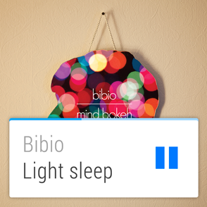
Design principles are based on how the user interacts with the device (based on several different elements of user input)
Notes:
Android Wear with the Android-L Preview example

Slide 58
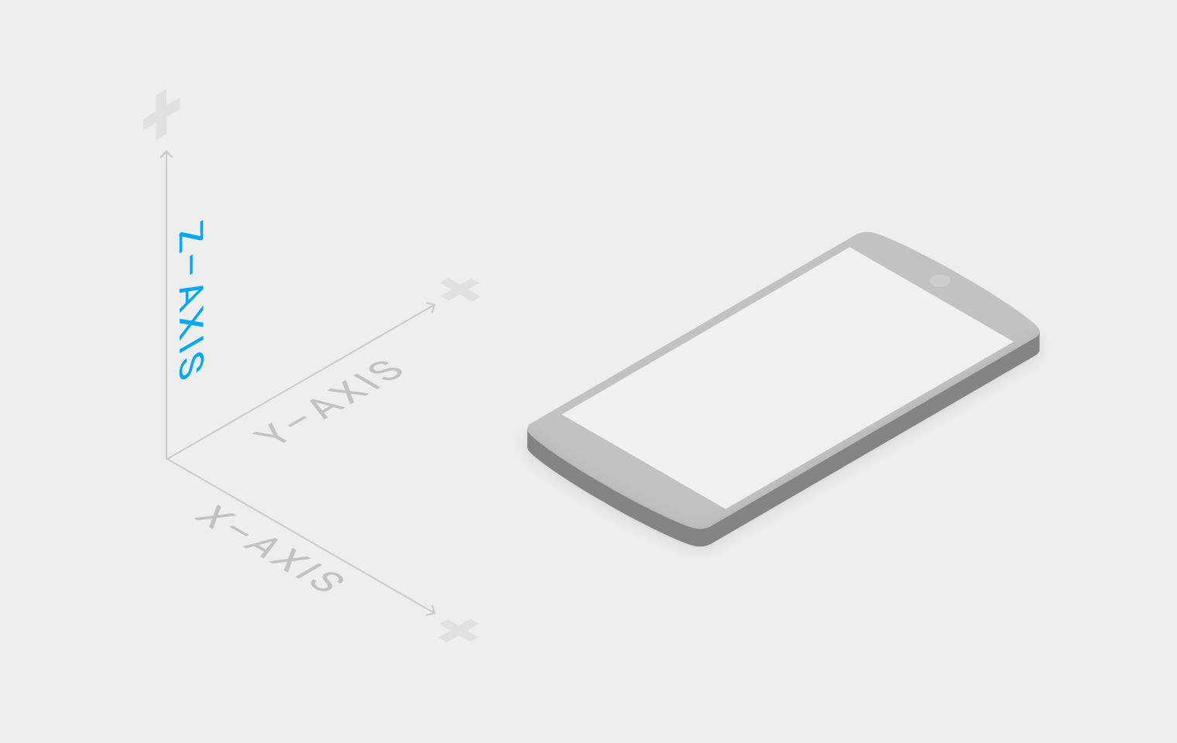
Notes:
Materials introduces the Z Axis and the global light source variable

Slide 59
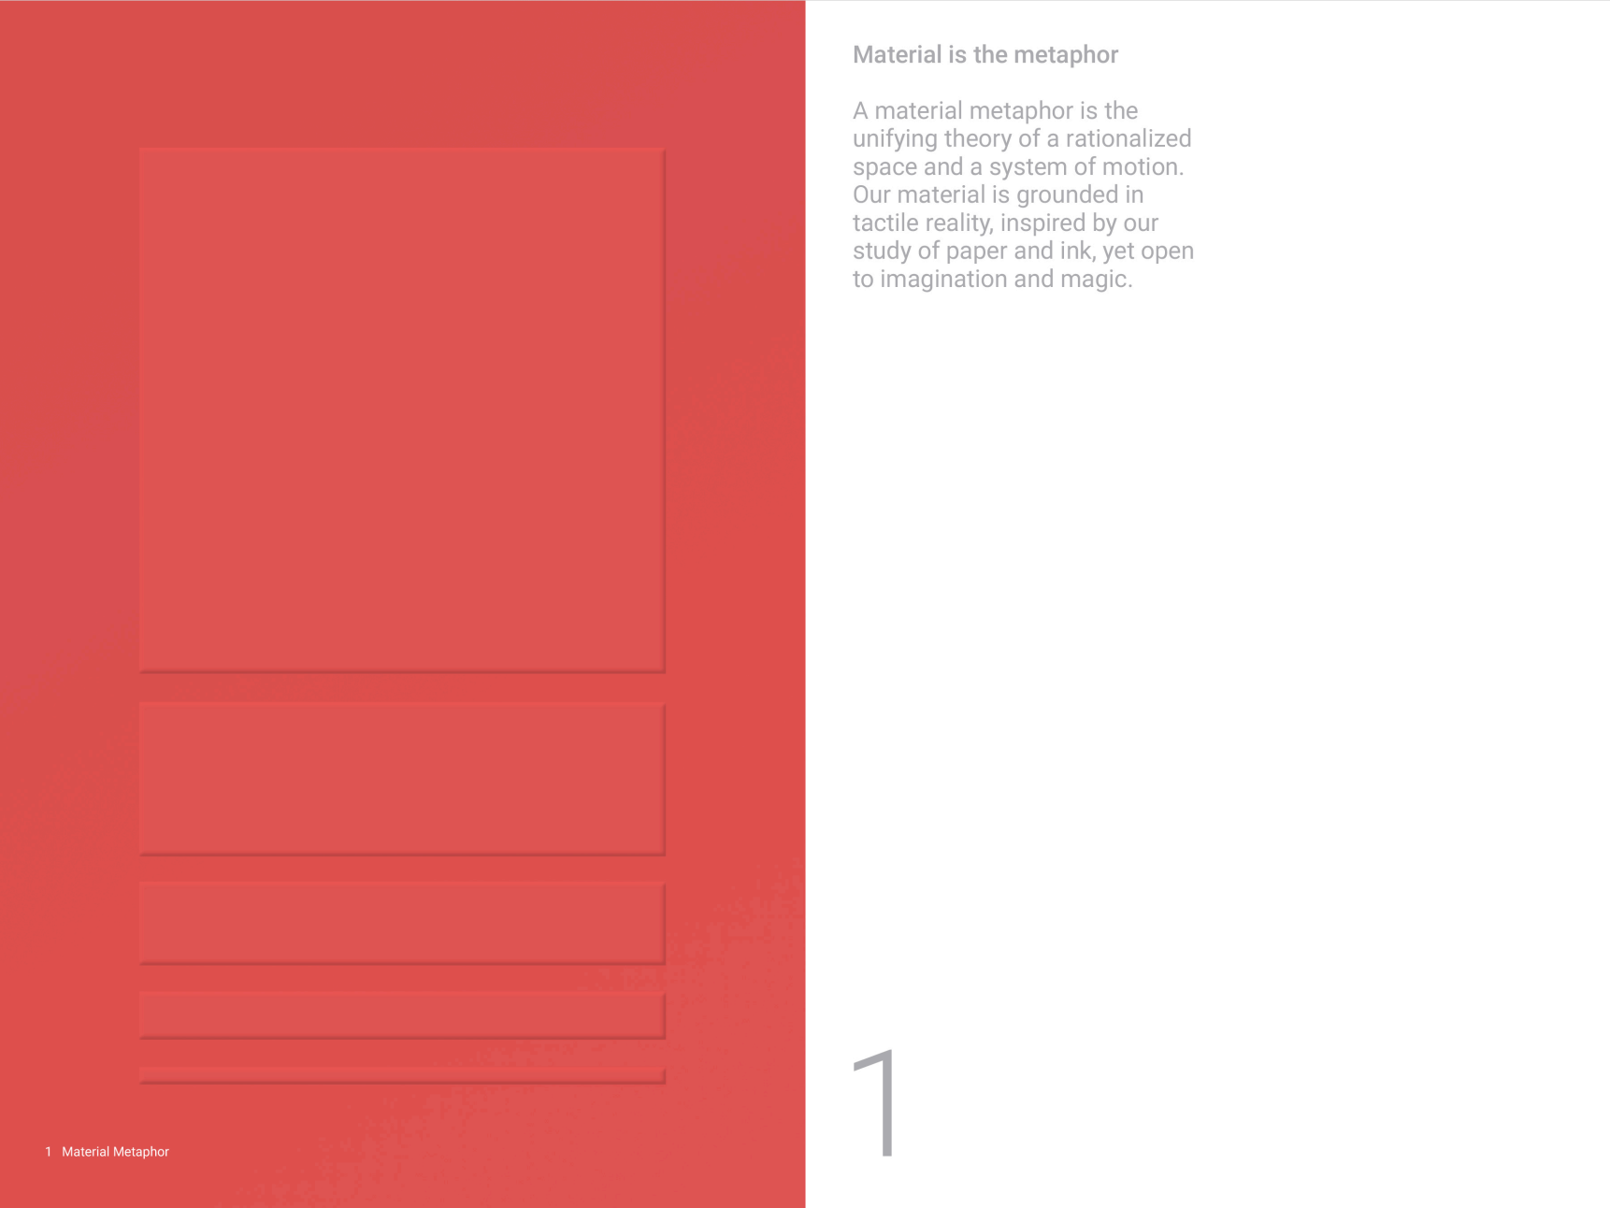
Notes:
1 Material Metaphor
Material is the metaphor
A material metaphor is the unifying theory of a rationalized space and a system of motion. Our material is grounded in tactile reality, inspired by our study of paper and ink, yet open to imagination and magic.
All these slides from the materials style guide :) http://www.google.com/design/spec/material-design/introduction.html

Slide 60
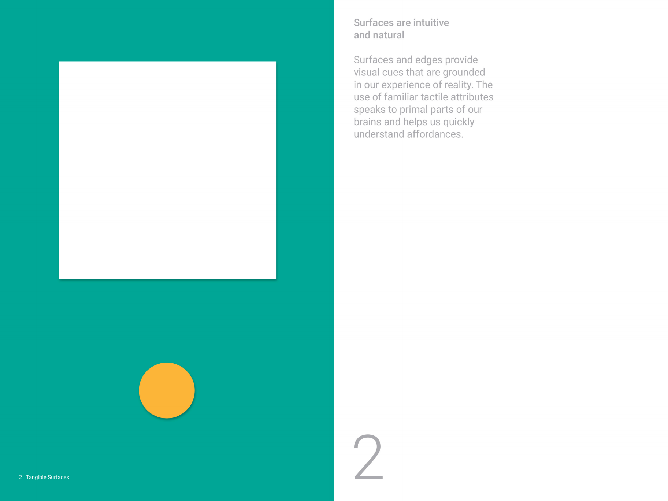
Notes:
(Ink)
2 Tangible Surfaces
Surfaces are intuitive and natural
Surfaces and edges provide visual cues that are grounded in our experience of reality. The use of familiar tactile attributes speaks to primal parts of our brains and helps us quickly understand affordances.

Slide 61
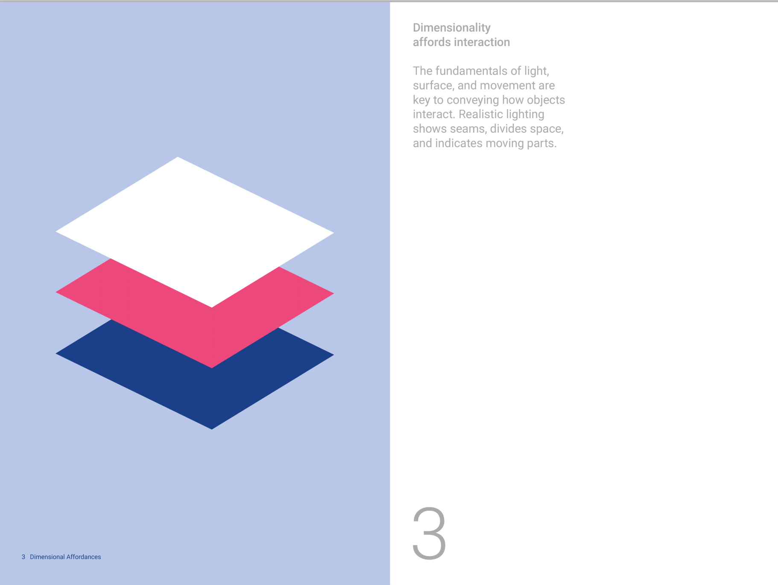
Notes:
(Z axis and shadows)
3 Dimensional Affordances
Dimensionality affords interaction
The fundamentals of light, surface, and movement are key to conveying how objects interact. Realistic lighting shows seams, divides space, and indicates moving parts.

Slide 62
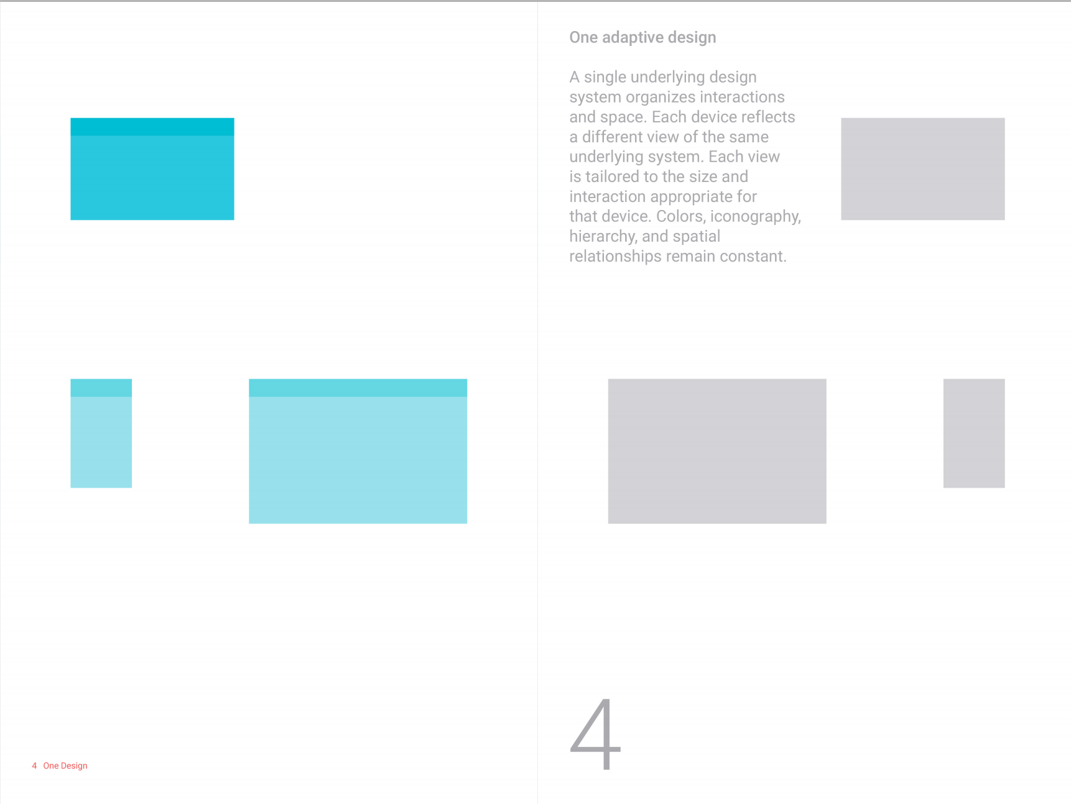
Notes:
Auto scales for phone, tablet, desktop, aaand wearables
4 One Design
One adaptive design
A single underlying design system organizes interactions and space. Each device reflects a different view of the same underlying system. Each view
is tailored to the size and interaction appropriate for
that device. Colors, iconography, hierarchy, and spatial relationships remain constant.

Slide 63
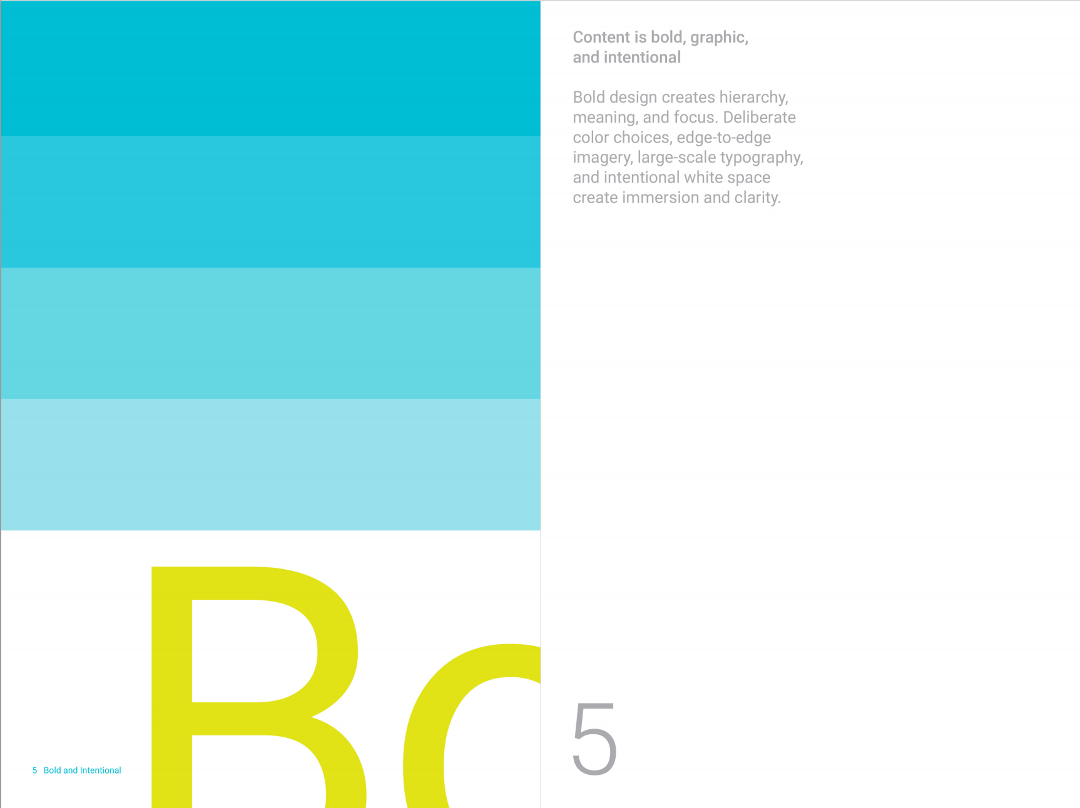
Notes:
5 Bold and Intentional
Content is bold, graphic, and intentional
Bold design creates hierarchy, meaning, and focus. Deliberate color choices, edge-to-edge imagery, large-scale typography, and intentional White space create immersion and clarity.

Slide 64
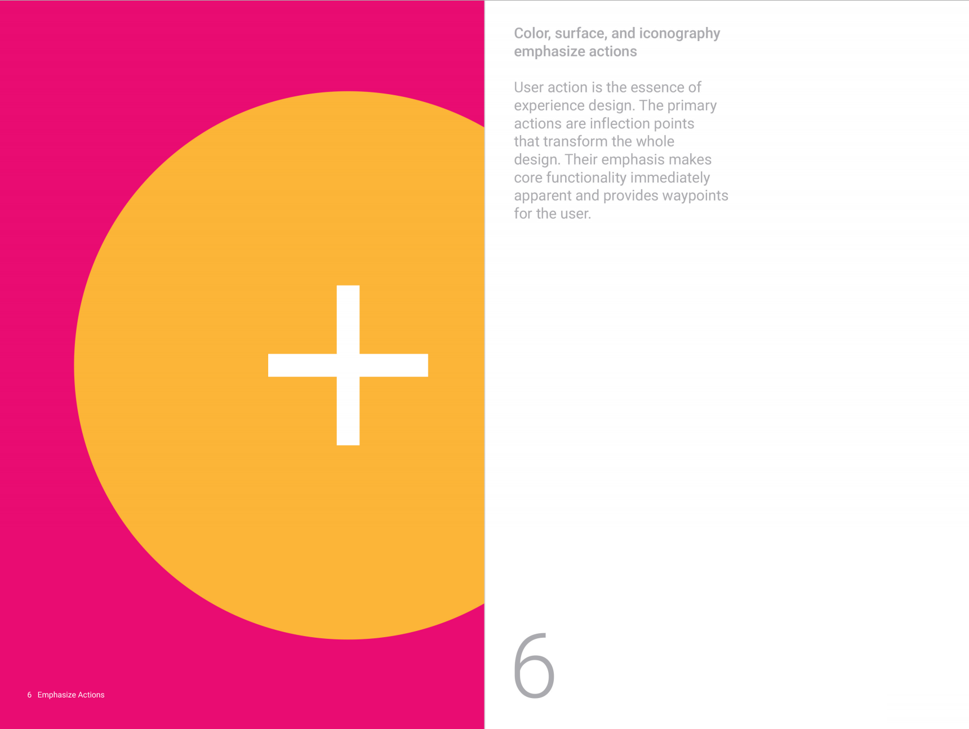
Notes:
6 Emphasize Actions
Color, surface, and iconography emphasize actions
User action is the essence of experience design. The primary actions are inflection points
that transform the Whole
design. Their emphasis makes core functionality immediately apparent and provides waypoints for the user.

Slide 65
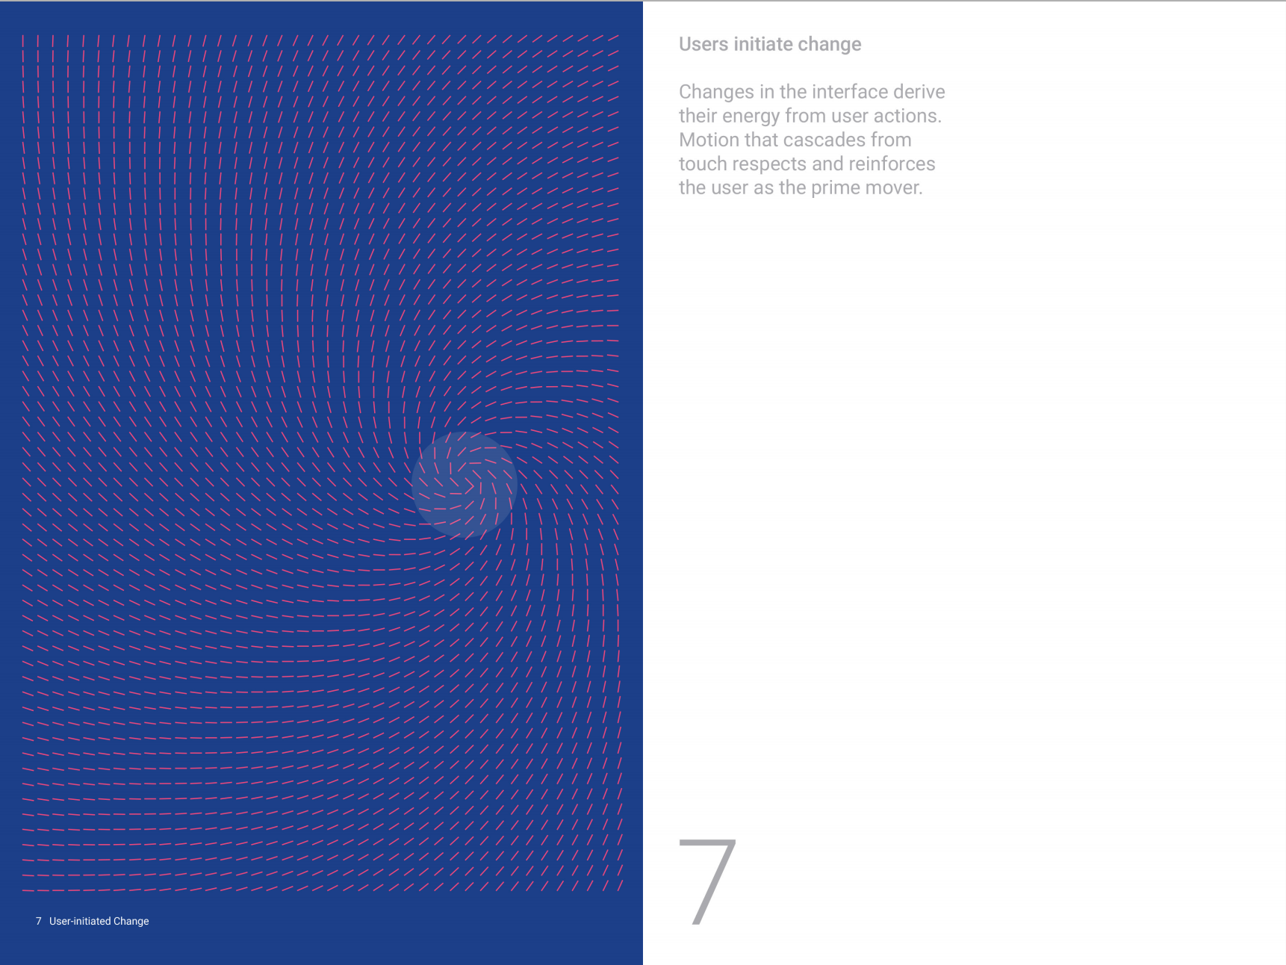
Notes:
7 User-initiated Change
Users initiate change
Changes in the interface derive
their energy from user actions. Motion that cascades from touch respects and reinforces the user as the prime mover

Slide 66
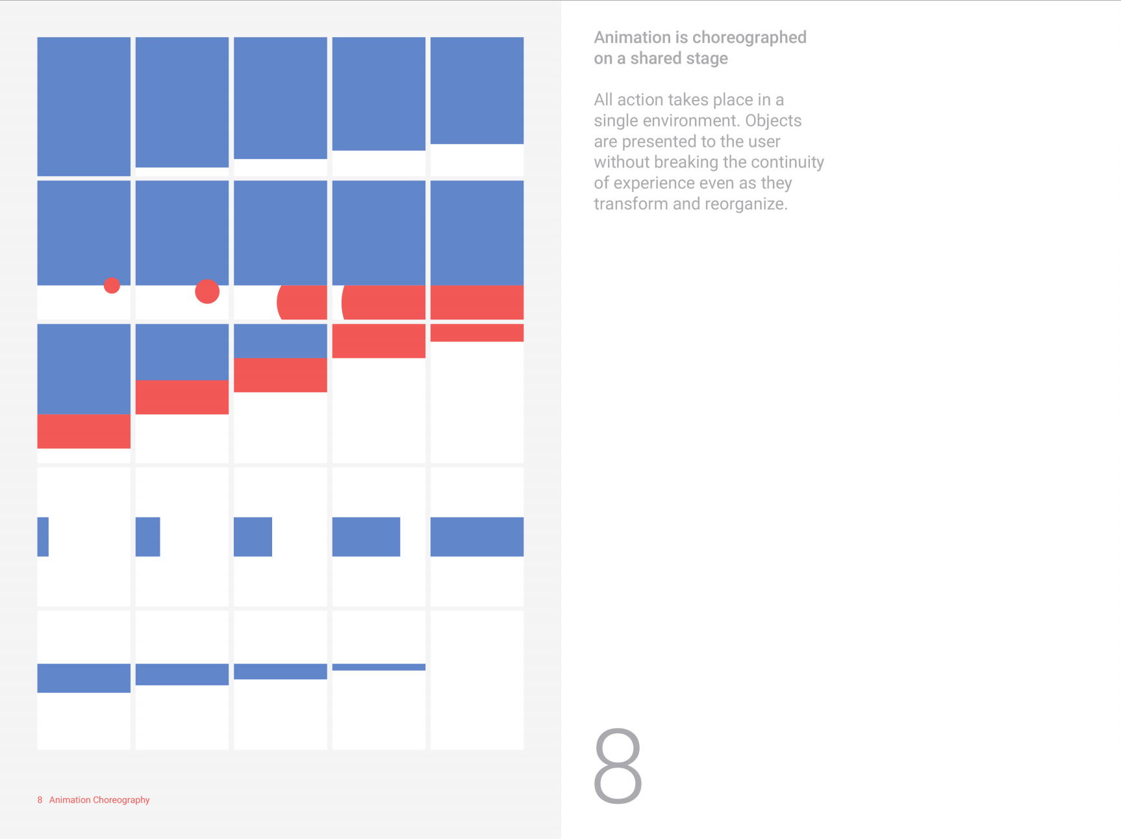
Notes:
8 Animation Choreography
Animation is choreographed on a shared stage
All action takes place in a single environment. Objects are presented to the user Without breaking the continuity of experience even as they transform and reorganize.

Slide 67
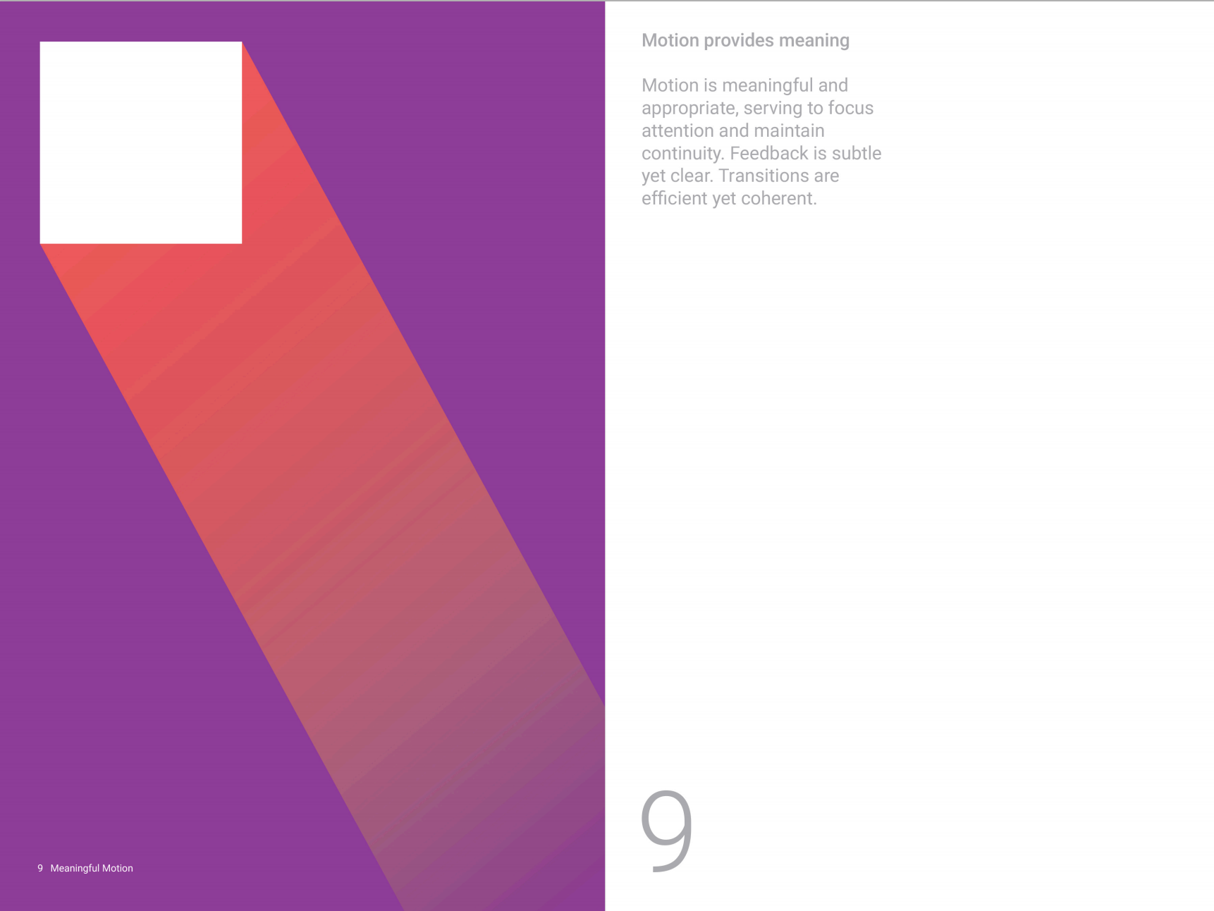
Notes:
9 Meaningful Motion
Motion provides meaning
Motion is meaningful and appropriate, serving to focus attention and maintain continuity. Feedback is subtle yet clear. Transitions are efficient yet coherent.

Slide 68
Topeka!
https://polymer-topeka.appspot.com/

Slide 69
Take Home
‘Web Components allow you to create custom HTML elements.
Polymer is just an opinionated way to work with Web Components.’
-Rob Dodson
Notes:
If i can sum up polymer in 2 sentences, it would be this.

Slide 70
</polymer-project>
// Google Developer Group Atlanta+Jonathan Popham
Notes:
[Two more slides after this]
It would be funny if i actually made this presentation into a custom element X;^D http://www.polymer-project.org/tools/designer/preview.html#b37c0c07ec8d7cebbe00 play this if there is still time leftover( ROB DODSON SFHTML5 DEMO FROM April 19) https://www.youtube.com/watch?feature=player_detailpage&v=mN7IAaRdi_k#t=9697

Slide 71
GDG Atlanta
http://www.meetup.com/gdg-atlanta/
Notes:
Last slide before Question slide
Come to our other events!

Slide 72
Questions?

Slide 73
bonus slide
polymer is not xml schema
-” jQuery : DOM :: X-Tag/Polymer : Web Components.”
// x-tag.org/blog

Slide 74
bonus slide
Words to Know:
Shadow Hosts
Shadow Trees
Shadow Roots
Elder/Younger nomenclature
Insertion Points
Event Retargeting
POOL population algorithm

Slide 75
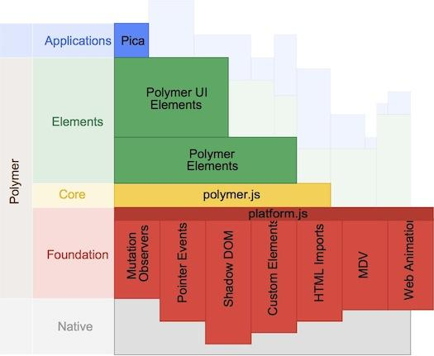
Polymer Layers
Notes:
Not included in talk but here for posterity. “Kind of out of date. polymer-* and polymer-ui-* stuff was deprecated
You could replace the part that says “Polymer Elements” with “Core Elements” and the Polymer UI Elements with “Paper Elements”. The core stuff is our bedrock, it’s not heavily stylized but it’s meant to give you good scaffolding. We used the core elements to build the paper elements. Paper elements are more stylized, they’re kind of an expression of what you can do when you build on top of the core stuff to create a full thought out design system. The paper elements are part of Google’s “Material Design” system” -Rob Dodson

